Slide 1
Team No Name
Week 8
Stand-up
Health & Wellbeing

Slide 2
TABLE OF CONTENTS
01
04
02
05
03
06
Introduction
Concept
Introducing the domain and problem space
Primary Research
Initial Designs
Surveys and Interviews were conducted to justify a problem
Initial functionalities and ideas
Design Opportunities
Future Plans

Slide 3
Introduction
Domain
Problem space
Health & Wellbeing
How to help doctors and patients communicate effectively by improving diagnosis accuracy？

Slide 4
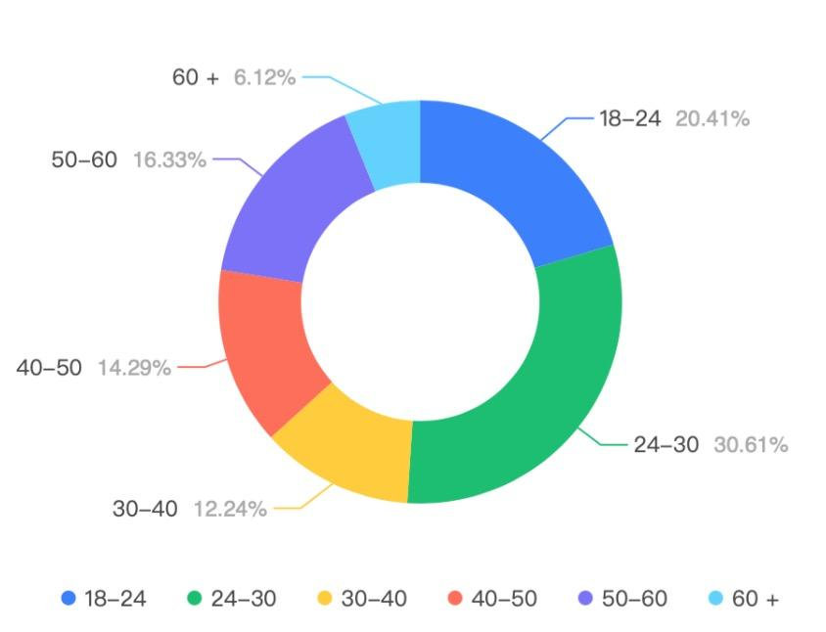
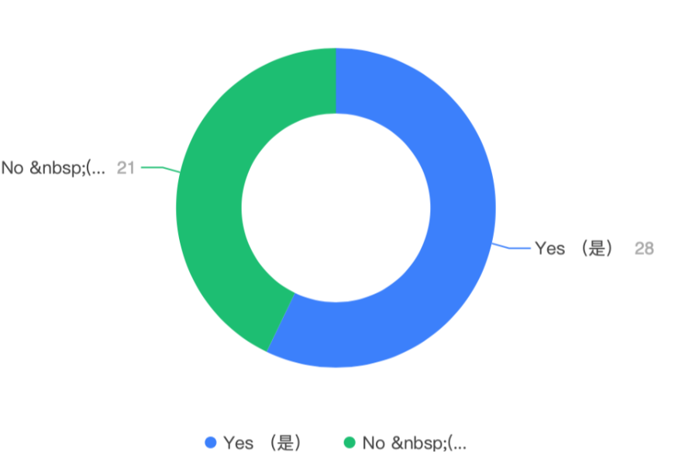
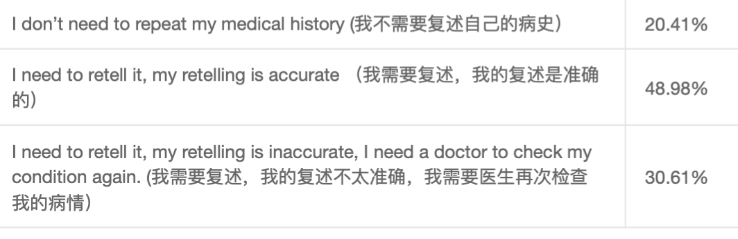
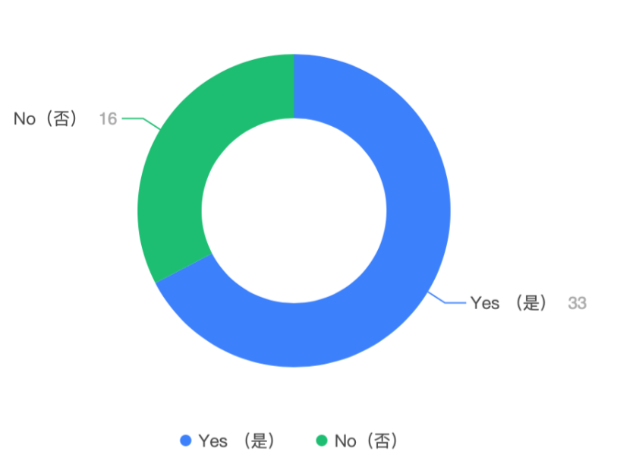
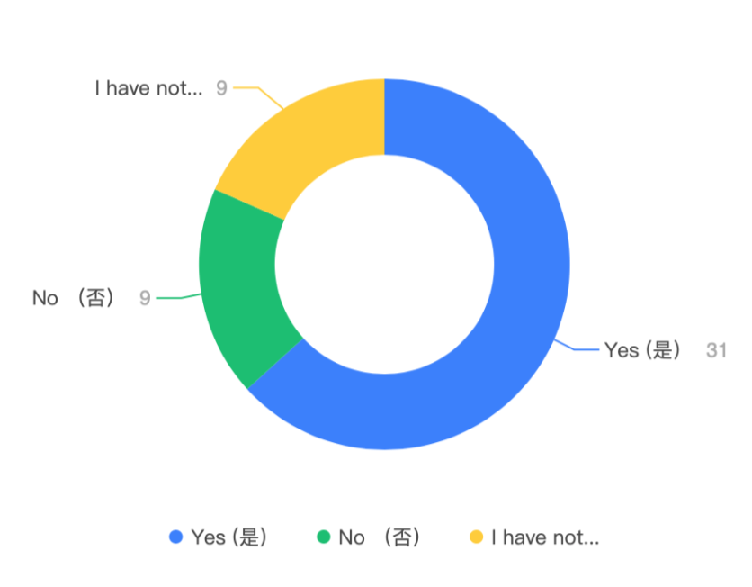
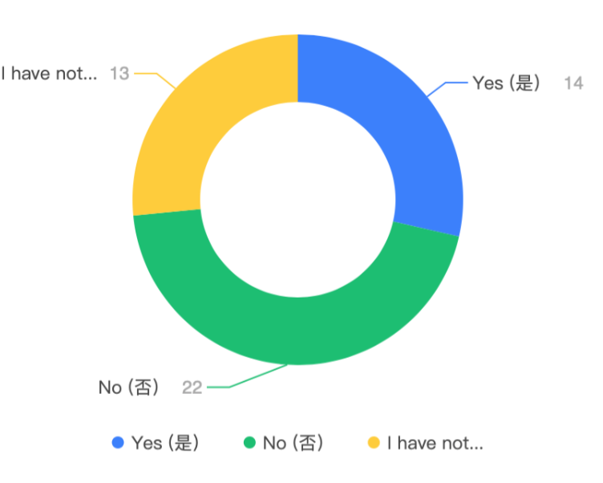
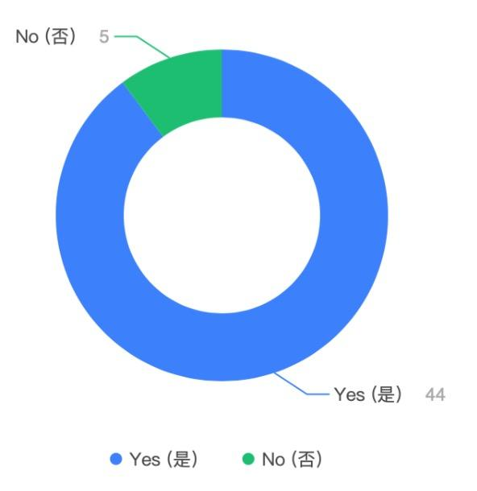
Survey Results
When you want to review, do you think it is difficult to find the same doctor for review?
Do you have to retell your medical history when you need returning visit ? If you do encounter this situation, can you accurately describe your medical history when you see a new doctor?
Have you ever experienced the situation of changing a hospital to continue your treatment?
When you change a hospital to treat the same disease, will the new doctor ask you to do the same test as before to confirm your condition?
In an emergency, can you quickly find a suitable hospital for treatment in an unfamiliar place?
Have you ever forgotten to ask about something during an appointment

Slide 5
Expert Interview Results
Questions
How long does the conversation about the previous condition take and are their answers accurate and sufficient?
How often is patient information being shared among medical institutions?
What kind of data do you look at in a past medical history? (previous medications/surgeries etc.)
What kind of patient would require you to ask about their experience from previous illnesses?
What kinds of questions regarding these past medical history will be asked from the patient?
When formulating a treatment plan for a patient, how critical is it to pay attention to the patient's experience in treating the disease? Why is that?
Information are not often shared among medical institutions
Knowing patient information is critical in formulating medications and treatment plans
Asking patients questions is very important and their answers are valuable.
Interview Findings

Slide 6
Patient Interview Results
Questions
What do you think about the security of sharing these patient information? Could you elaborate further?
What are your thoughts on medical institutions sharing your patient information regarding health issues so that no matter which institution you went to they would know your medical record?
Have you ever been to a new medical institution that knew what your previous conditions were?
What are the ways you use to provide information to these medical institutions?
Have you had any experiences where you were frustrated when providing information to multiple medical institutions?
What sort of technology (app, web, etc.) would you think might be best for storing and transmitting data? Can you elaborate on that?
Patients usually have to complete a form however some bring their own documentations as they are unable to remember the full details
Data sharing must follow strict rules (permissions) in order to gain the trust of patients
Patients do not visit other medical institutions due to issues with understanding of the patient’s condition
An app is widely perceived to be more mobile and convenient for patients
Interview Findings

Slide 7
Design Opportunities
Tracking and review of past doctors - can help patients for a positive experience about next consultation
Standardisation of health records across different hospitals for seamless transition between different medical providers
Allow for saving of common questions so that patients will not forget important notes about their condition

Slide 8


Concept
A patient-oriented website/mobile app that allows patients to store their own medical records online, and this app supports patients to share their medical records between different hospitals with information privacy protection.

Slide 9
Initial Design
Health data
Find nearby hospitals
Help patients who are in an emergency or not familiar with the local situation simple to research and navigate healthcare providers
Medical record
Allergy and Medications
Health Management
The doctors transmit the medical records to the patient
Drug allergy and adverse drug reaction record
Medication & dosage instruction
Detailed record of Blood Pressure, Heart Rate and Blood Glucose
Sharing of health records
Online communication
The user consent to transmit the information to the doctor they made an appointment
Create a seamless connection with healthcare providers, enabling more efficient and quality healthcare services
Asynchronous communication
Leave a message to the doctor

Slide 10
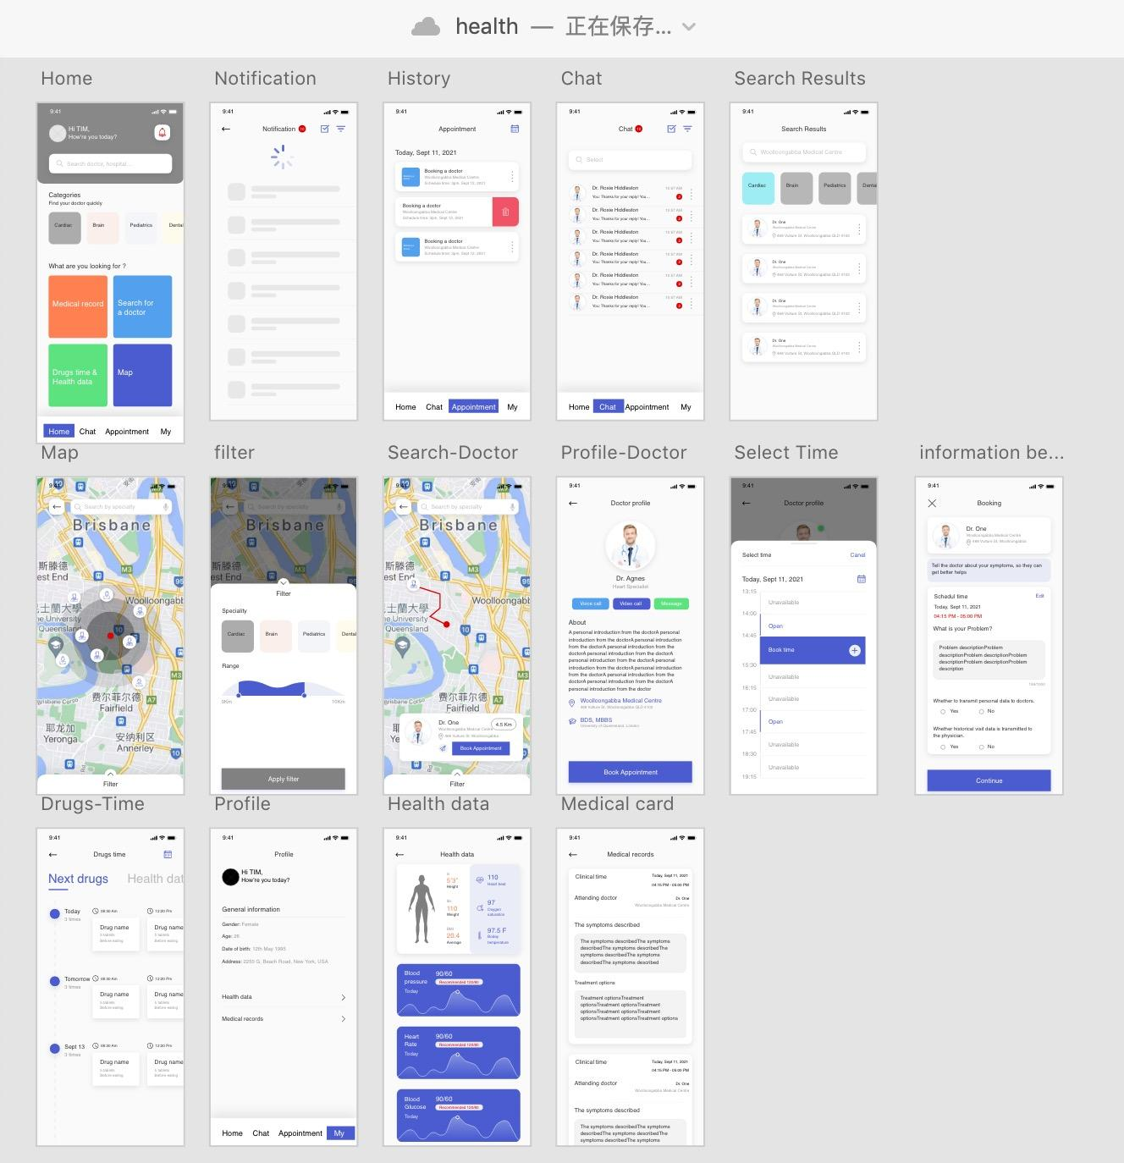
Prototype

Slide 11
Future Plan
DAY 1
DAY 2
DAY 3
DAY 4
DAY 5
Initial Evaluation
Formal Evaluation
1
2
3
4
Making up Initial prototyping
Iteration

Slide 12
THANKS
Does anyone have any questions?

Slide 13
REFERENCES
AUTHOR (YEAR). Title of the publication. Publisher
AUTHOR (YEAR). Title of the publication. Publisher
AUTHOR (YEAR). Title of the publication. Publisher
AUTHOR (YEAR). Title of the publication. Publisher
AUTHOR (YEAR). Title of the publication. Publisher
AUTHOR (YEAR). Title of the publication. Publisher

